Slide 1


E-Commerce Multi-Category store predictive analysis with machine learning models using spark ml
CIS 5560
Professor Jongwook Woo
Submitted By:
Shailja Pandit
Anish Omprakash Pandey
Surya Kiran Golagani

Slide 2
About the dataset
This e-Commerce website helps people View and Purchase the product of almost any category.
The objective of this project is to build a model that predicts the optimal price of a product considering the features of the product details.
This dataset contains events from an eCommerce website for a large multi-category online store for the month of October 2019.
Each row in the file represents an event. All events are related to products and users. Each event is like a many-to-many relationship between products and the users.
Data is collected by the Open CDP project.
The objective of this project is to build a model that predicts the optimal price of an Item considering the features of the listings.

Slide 3
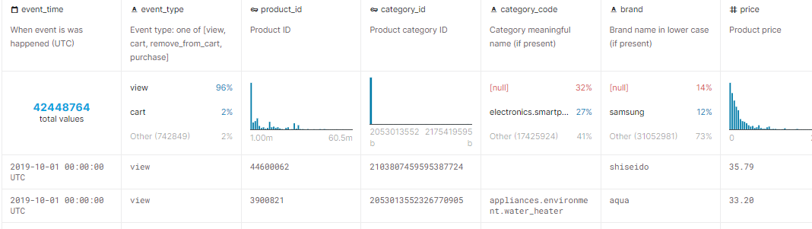
DATASET Specifications
DATASET NAME: eCommerce behavior data from multi-category store
TOTAL DATASET SIZE: 5 GB
DATASET FORMAT: CSV
DATASET URL:
https://www.kaggle.com/datasets/mkechinov/ecommerce-behavior-data-from-multi-category-store?select=2019-Oct.csv

Slide 4



TECHNICAL specification
Databricks Community Version: 10.4 LTS (includes Apache Spark 3.1.1, Scala 2.12)
File System: DBFS (Data Bricks File System)
Nodes: 1
Python Version: 3.10.4
Memory: 2.5 GHz, 6 cores, 1 DBU,
PySpark version : 3.0
Nodes: 3

Slide 5
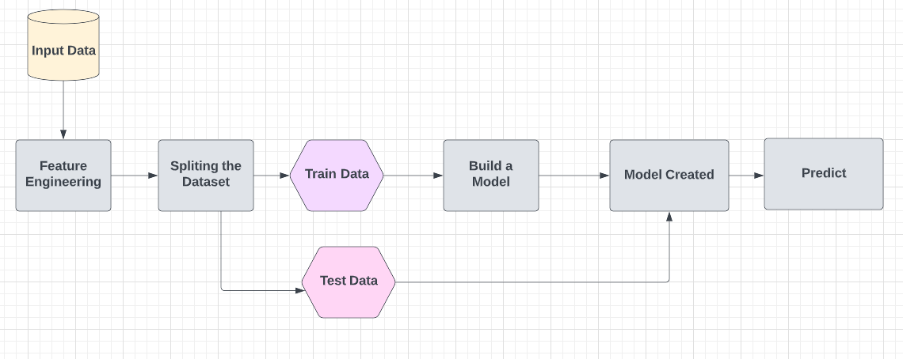
Prediction System Flowchart

Slide 6
Machine Learning Algorithms Used
Item Price Prediction:
Gradient Boost Tree Regression
Decision Tree Regression
Random Forest Regression
Linear Regression
Event Type Prediction:
Decision Tree Classifier

Slide 7
What is Regression?
Regression analysis is a set of statistical processes for estimating the relationships between a dependent variable (often called the 'outcome' or 'response' variable) and one or more independent variables (often called 'predictors', 'covariates', 'explanatory variables' or 'features')

Slide 8
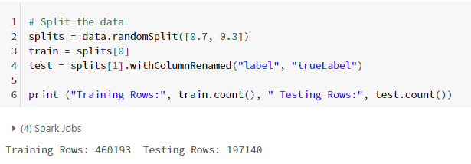
Splitting the dataset

Slide 9
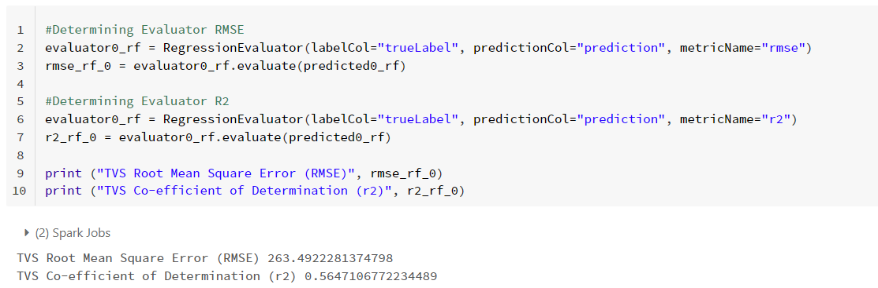
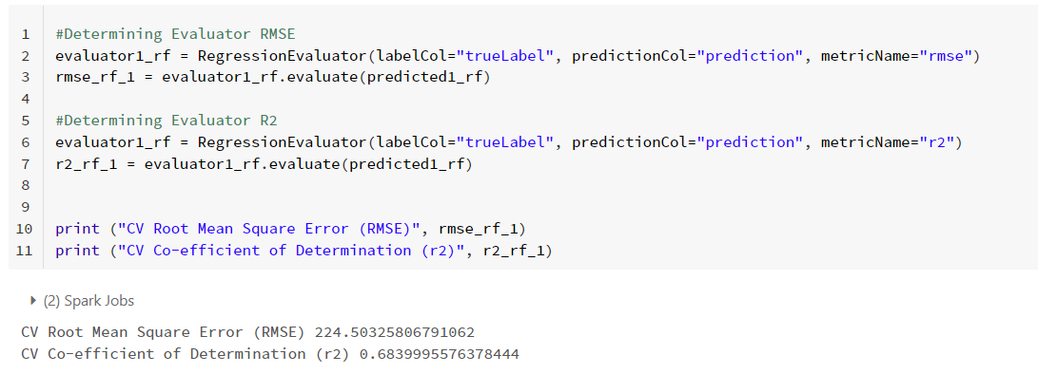
Random Forest - REGRESSION
TSV
Sampled File Size: 134 MB
Split Train/Test:70:30
Main modules:
Tune Model Hyperparameters
Cross Validate Model
Train Split Validator Model
CV

Slide 10
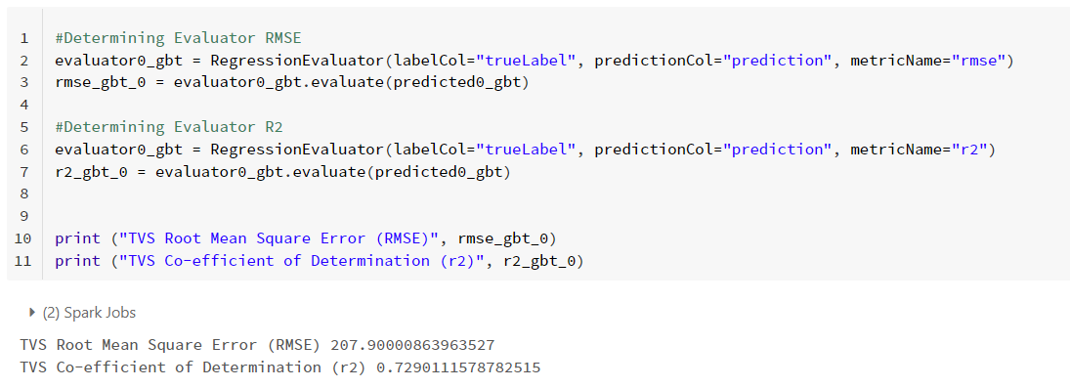
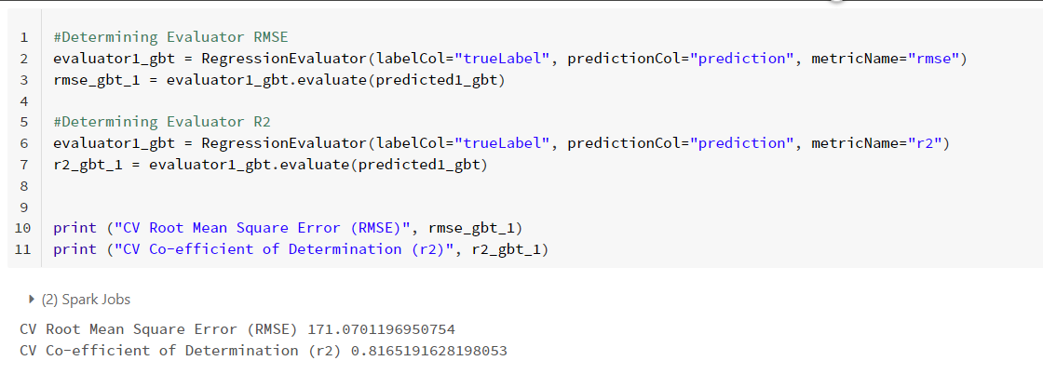
Gradient Boost Tree- Regression
TSV
Sampled File Size: 134 MB
Split Train/Test:70:30
Main modules:
Tune Model Hyperparameters
Train Split Validator Model
Cross Validate Model
Feature Importance
CV

Slide 11
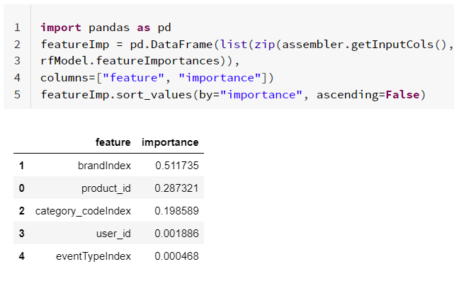
Feature Importance
Feature Importance refers to techniques that calculate a score for all the input features for a given model — the scores simply represent the “importance” of each feature. A higher score means that the specific feature will have a larger effect on the model that is being used to predict a certain variable.

Slide 12
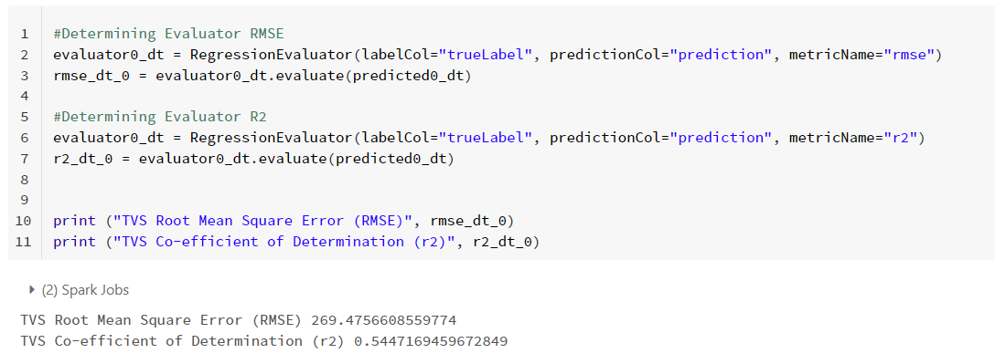
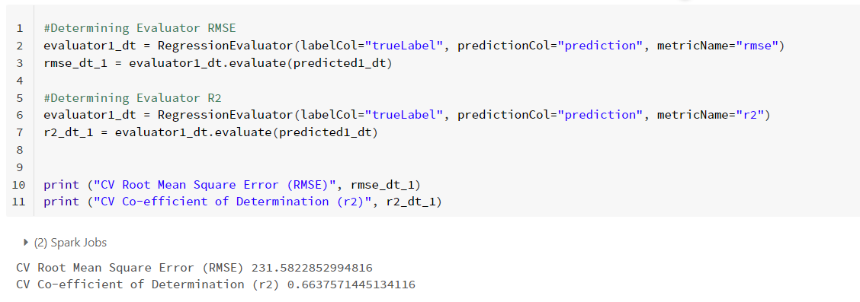
Decision Tree - REGRESSION
TSV
Sampled File Size: 134 MB
Split Train/Test:70:30
Main modules:
Tune Model Hyperparameters
Train Split Validator Model
Cross Validate Model
CV

Slide 13
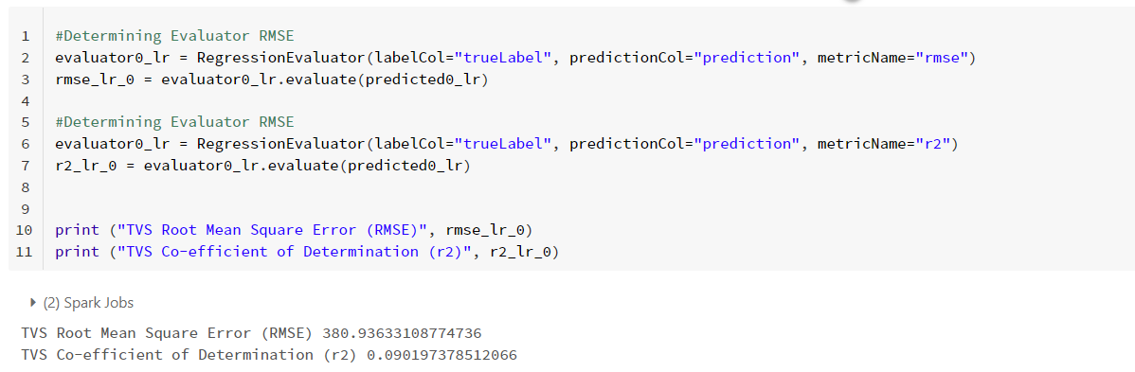
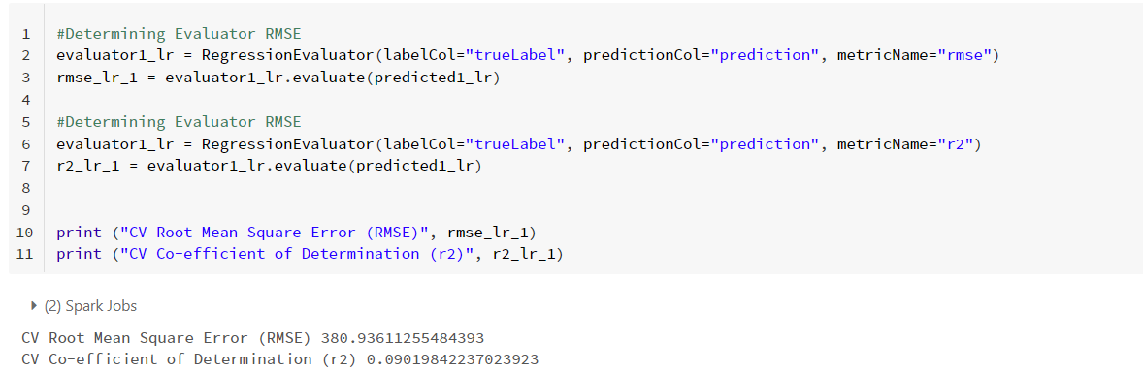
Linear regression
TSV
Sampled File Size: 134 MB
Split Train/Test:70:30
Main modules:
Tune Model Hyperparameters
Train Split Validator Model
Cross Validate Model
CV

Slide 14
Regression Comparison table
Algorithms | RMSE | R2 | Time Taken to run the Model
Random Forest | 224.50 | 0.68 | 3.75 minutes
Gradient Boost Tree | 171.07 | 0.81 | 12.26 minutes
Decsion Tree | 231.58 | 0.66 | 2.27 minutes
Linear Regression | 380.93 | 0.09 | 1.53 minutes

Slide 15
What is Classification?
Classification is the process of predicting the class of given data points. Classes are sometimes called targets/ labels or categories.
There are mainly 2 types of classifications:
Binary Classification
Multi-Class Classification
For our Project, we have used Multi-Class Classification because the Event Type Column consists of three classes:
View
Cart
Purchase

Slide 16
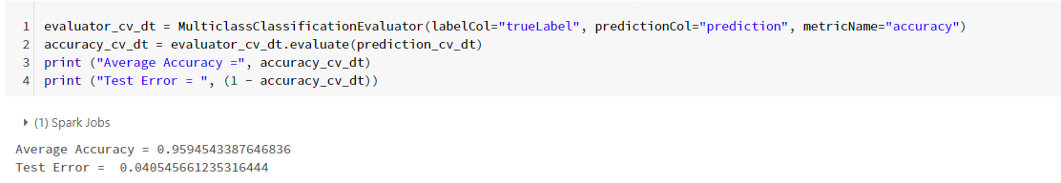
DECISION TREE CLassifier
CV
Sampled File Size: 134 MB
Split Train/Test : 70:30
Main modules:
Tune Model Hyperparameters
Cross Validate Model
Time: 3.21 mins

Slide 17
Github link
https://github.com/shailjapandit05/CIS-5560-e-Commerce-Prediction-Project

Slide 18
references
https://towardsdatascience.com/multi-class-text-classification-with-pyspark-7d78d022ed35
https://spark.apache.org/docs/latest/ml-classification-regression.html#multilayer-perceptron-classifier
https://spark.apache.org/docs/latest/ml-classification-regression.html#regression

Slide 19
SUMMARY
What did we learn?
We learned where and how to implement various algorithms.
We learned when to use Regression algorithms and when to use Classification.
We learned the difference between Binary Classification and Multi-Class Classification
We learned which one is a better model- Cross Validator or Train Split Validation
We learned the use of calculating ‘Feature Importance’
We learned how to compare the accuracy of different models based on R2, RMSE and Accuracy

